Slide 1
Crisis and Change, 1675–1720
Chapter 3

Slide 2
Rebellions and War
Decline of New England Orthodoxy
King Philip’s War, 1675–1676
War in the Chesapeake - Bacon’s Rebellion
The Pueblo Revolt, 1680–1693
Notes:
I. From Massachusetts to New Mexico, European settlement patterns contributed to a series of disagreements, rebellions, and wars during the late 1600s.
A. The decline of strong church orthodoxy in New England, combined with the growth of other religions, led to periods of religious unrest, especially between Puritans and Quakers.
B. When the Algonquian leader Metacom, also known as King Philip, tried to rally his people to fight settlers in New England, the Indians were severely put down.
C. A serious problem arose in Virginia, with the uprising known as Bacon’s Rebellion.
1. Nathaniel Bacon led a group that attempted to convince the colonial government to seize land from local Indians.
2. The rebellion came to an end after Bacon’s untimely death, with few significant changes taking place among the disgruntled settlers.

Slide 3
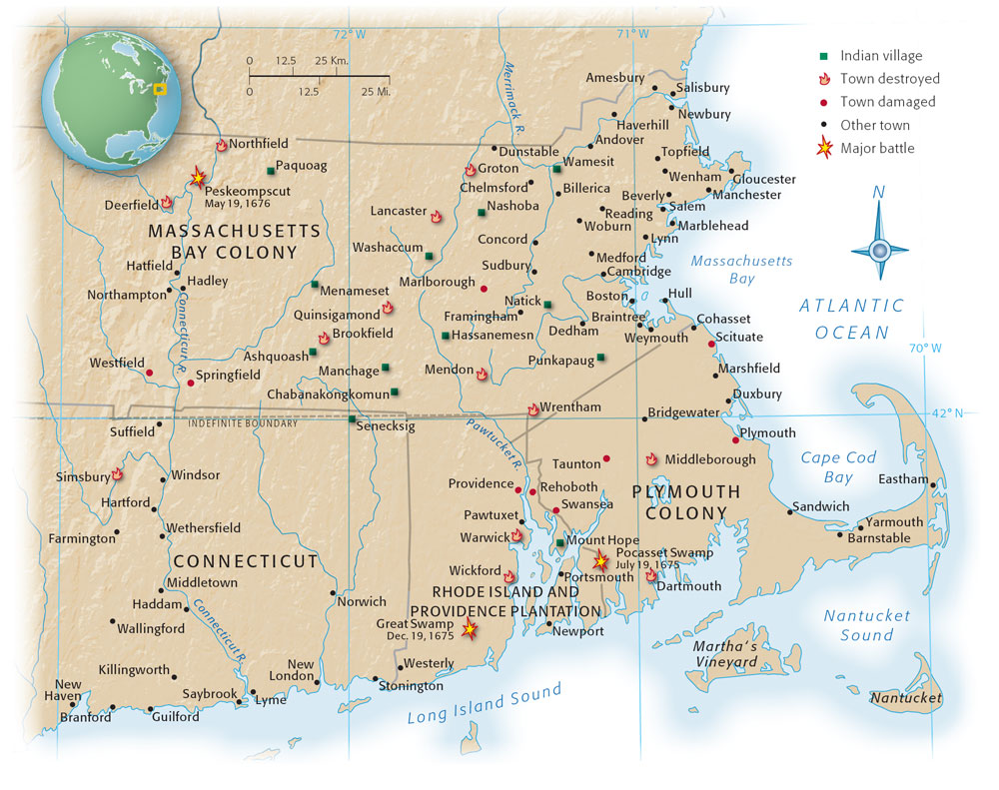
New England at the Time of King Philip’s War, 1675–1676
Took place in New England
Notes:
When the Algonquian leader Metacom, also known as King Philip, tried to rally his people to fight settlers in New England, the Indians were severely put down.
The Indians and English destroyed and damaged each other’s towns throughout Plymouth, Rhode Island, and Massachusetts. The Narragansetts, who lived in Rhode Island and had assisted the Puritan governments against the Pequots in 1637, entered King Philip’s War after an English army invaded their territory.

Slide 4
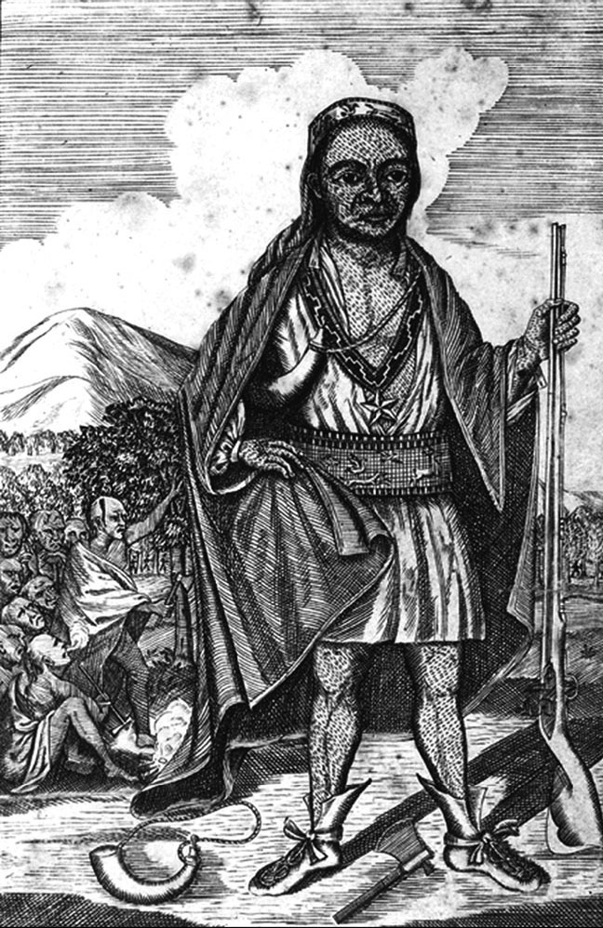
Metacom
Metacom, the Wampanoag leader, who in 1676 tried to drive the New England settlers back “into the Sea.”
The Granger Collection

Slide 5
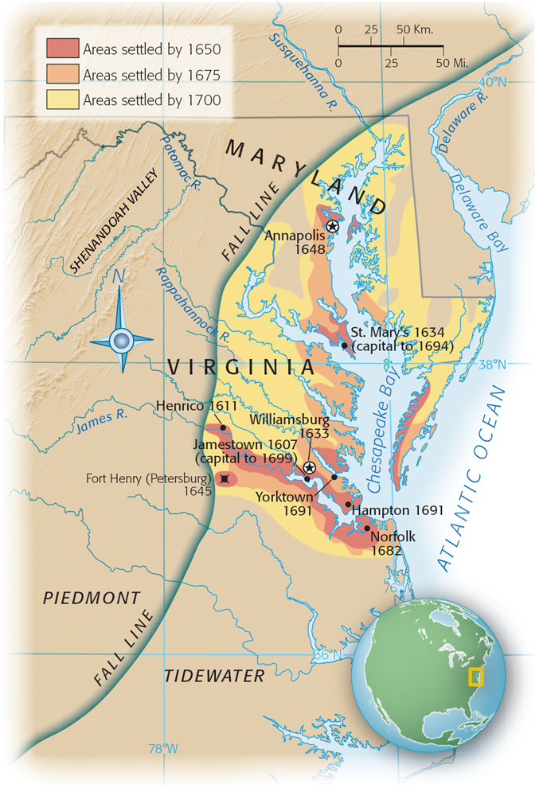
Expansion in the Chesapeake Colonies, 1650–1700
The settler population of Virginia and Maryland grew slowly until the 1640s and then increased to forty thousand by 1670.
The resulting competition for land contributed to the outbreak of Bacon’s Rebellion.
In the wake of the uprising, settlers pushed into former Indian lands north of the York River.

Slide 6
Bacon’s Rebellion - 1674
Governor Berkeley of Virginia abused his power
  Gave favor to his friends the Green Springs Clique
  Colonists are upset with the obvious favoritism
Berkeley faced many other problems
  Depressed tobacco market
  Many believed the Crown was corrupt in it’s handling of land
  Raised taxes to forts to protect the coast and the western border from constant attacks
  New defenses proved ineffective against Indian attacks
  Iroquois Indian attacks increase in 1675 as the Iroquois expand their search for furs
Nathaniel Bacon arrives in Virginia in 1674 and tries to get a license to trade with the Indians and is turned down because he is not in the clique
  Colonists rally around him and he becomes a leader willing to defend the colonists against the clique and Indian attacks in 1675
  Bacon demanded that Berkeley take action against the Indian threat and when he does not, Bacon takes matters into his own hands and gathers together a force of about 1000 men began a local campaign against the Indians

Slide 7
Bacon’s Rebellion - 1674
Berkeley reacts to Bacon’s actions
  Berkeley and his local government passes some reforms to try to appease the colonists to no avail
Bacon and his followers march to Jamestown to question the authority of local government which they feel is inadequate and illegitimate
  Bacon and his men take control of the capital of Virginia
  Berkeley arrests and executes 30+ of the rebels
  Berkeley kicked out of office
Bacon’s supporters were seen as the poor people of society – this results in bringing over fewer and fewer indentured servants and the importing of more and more African slaves
Crown and Parliament will watch the activities of the colonists more closely

Slide 8
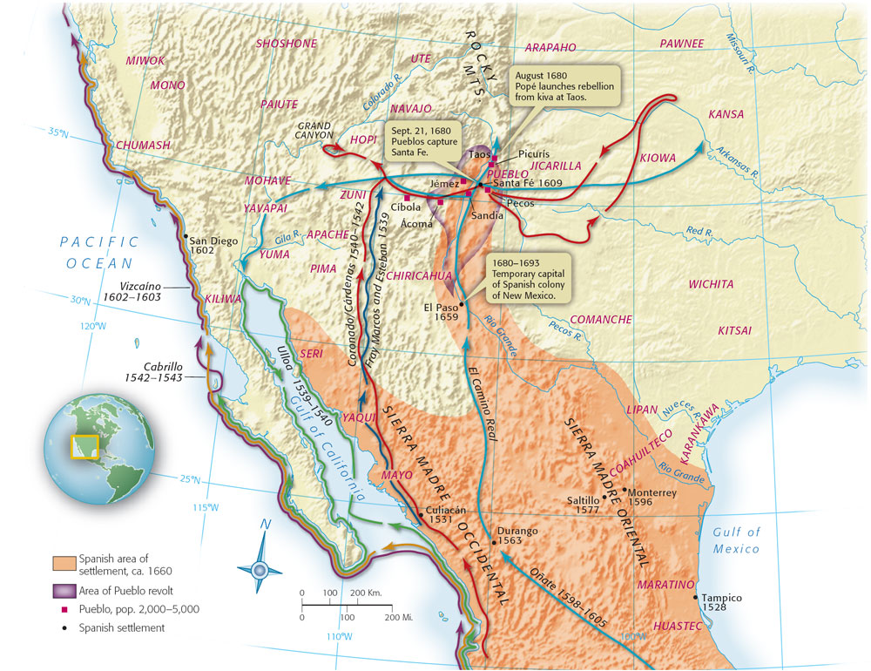
New Mexico in the Seventeenth Century
The Southwest was also unsettled, with the Pueblo Indian Popé leading an unsuccessful revolt against Spanish oppressors.
Notes:
The Spanish had established their colony in 1598 by sending soldiers, their families, and Franciscan missionaries north through the Rio Grande Valley. In 1680, at the time of the Pueblo Revolt, the Spanish population remained small and centered in the capital, Santa Fe.

Slide 9
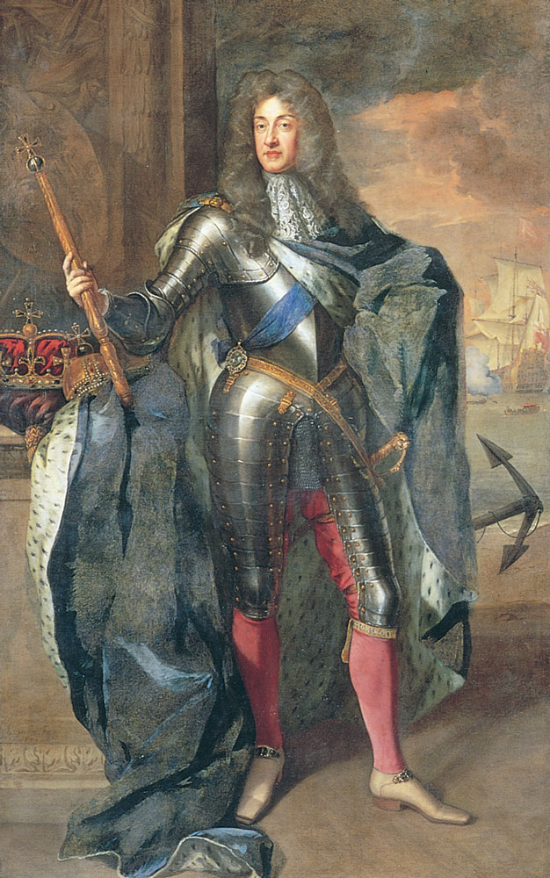
The Glorious Revolution in England, 1688–1689
The Glorious Revolution was more the climax of Parliament’s struggle with the king throughout the seventeenth century than a singular
Notes:
III. The Glorious Revolution in England brought changes for that country and for its colonies in America.
A. Concerned that the American colonies were becoming too self sufficient and headstrong, Charles II revoked the charter of Massachusetts and combined several colonies together into the Dominion of New England, which caused nothing but problems.
B. Revolutions occurred in 1689 both in England and in the colonies.
1. In the Glorious Revolution, William and Mary, supported by Parliament, replaced James II on the throne of England.
2. Protestant settlers in Massachusetts, New York, and Maryland also rebelled against a perceived threat from Catholics there.
3. While dissatisfaction and dissent within the colonies was becoming apparent, these early revolutions made little real difference in life there.
C. Societal turmoil in the New England colonies has also been blamed for the witchcraft hysteria that surfaced in Salem, Massachusetts in 1691-1692.
The Glorious Revolution was more the climax of Parliament’s struggle with the king throughout the seventeenth century than a singular affair. The events of 1688–1689 in England were bloodless, but could not have occurred without the violent conflict of the English Civil War four decades earlier, when King Charles I was beheaded. During the 1640s and1650s, Parliament first took control following the defeat of the monarchy and then, in disarray, named Oliver Cromwell solitary leader as Lord Protector of the Commonwealth

Slide 10
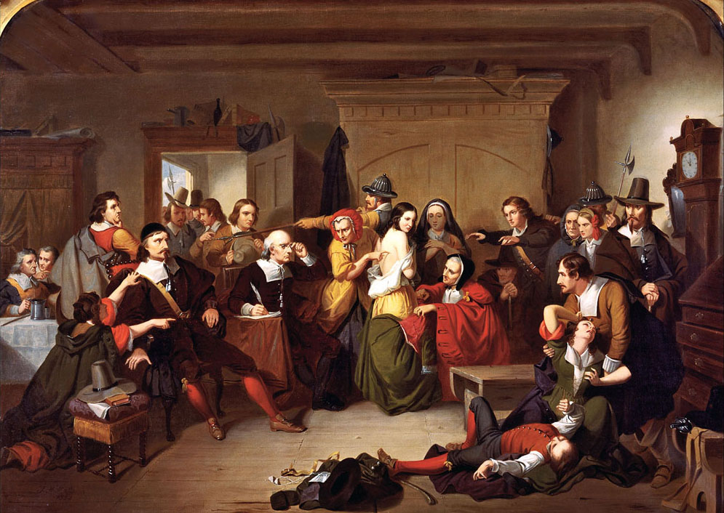
Witchcraft in New England
Examination of an Accused Witch
A mid-nineteenth century painting by Tompkins Harrison Matteson depicting a physical examination of a young girl for a devil’s mark, which would be considered evidence that she was a witch.
Notes:
Beginning in 1691 – there was a period of rapid change, where things are happening that people can’t really explain
The economy, for example, in these old Puritan farming towns are diversifying.
Fear that these changes are acts of either God or the Devil – scared and feel uneasy
People will react, in Salem, witchcraft hysteria takes over
Girls overreact to images they think they see and are overcome with episodes of fits
Rumors are rampant that these girls were cursed by the devil
Speculate if there are witches in Salem or not
1692 arrest warrants are going out
Ultimately 19 were hung and one man was stoned to death
By the time it was over 150 men and women were arrested and tried for witchcraft
What’s really happened?
Economy in Salem is diversifying – split between those who land locked and those who diversified (merchants, etc)
Commercialism is taking over in New England and leaving farming behind
2 Families
Putnam’s: old money, land locked and landholding is dwindling
Porter’s: new money, diverse economic interests, married into town merchant elite
The Salem witch trials amount to not much more than economics

Slide 11
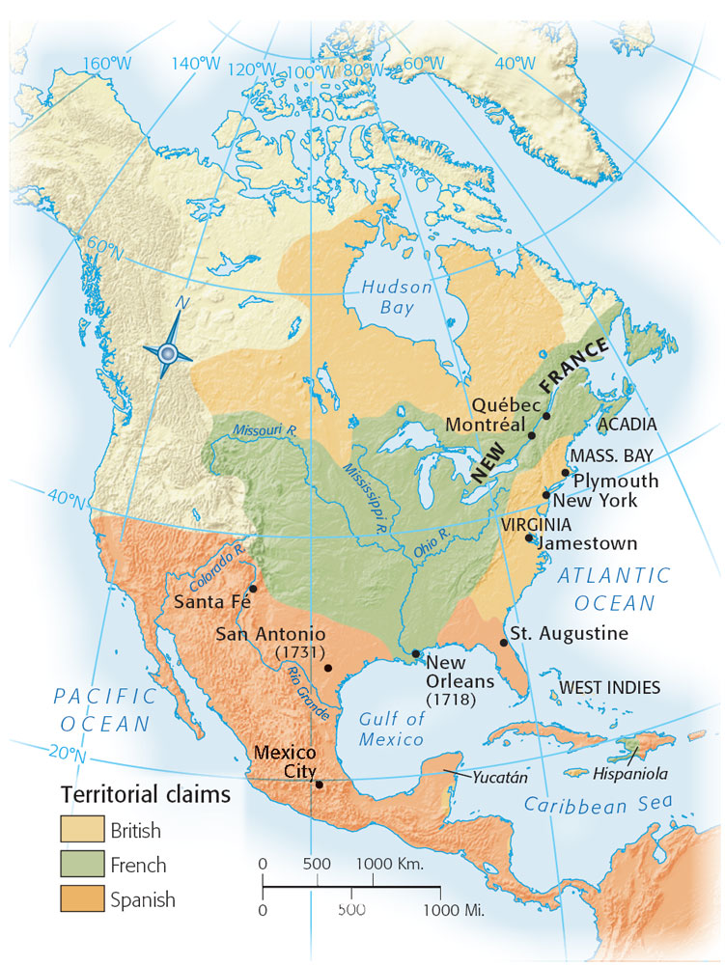
North America in 1700
The English, French, and Spanish vied for land in North America
Notes:
Significant change had occurred in North America since the early 1600s. Along the Atlantic coast, the English now had settlements from Maine (part of Massachusetts) to South Carolina. As the English population expanded, Native Americans declined, with many groups absorbed into other nations, such as the Catawbas of South Carolina.
IV. Rivalry for control of America led to a number of wars between Europeans and Native Americans, especially in the far north and far south.
A. In order to obtain control of trade centers and to gather slaves for the West Indies, English colonists in the Carolinas invaded Guale and Florida, driving out the Spanish and the native Apalachees in most places.
B. The French were in the vanguard in exploring and settling Louisiana, and their alliance with the Spanish enabled settlements to grow, albeit slowly.
C. In Canada, conflicts over trade routes and territory spilled into the Ohio Valley and down into frontier outposts in various places, and the settlement ending Queen Anne’s War left the French a powerful presence there.

Slide 12
The Entrenchment of
Slavery in British America
Adopting Slavery
The Slave Trade
Systems of Slavery in British North America
Resistance and Rebellion
Early Abolitionists
Notes:
V. Responding to economic conditions, European colonists began to embrace African slavery, a move that has been viewed as the most significant development of the colonial period.
A. The colonists believed themselves culturally superior to the Africans whom they enslaved, but their main reason for selecting Africans was that Native American slaves died in large numbers.
B. As the slave trade increased and the “middle passage” across the Atlantic became more common, the price of slaves declined, causing many more Africans to have to face the horrors of American life.
C. Systems of slavery in British North America varied according to the needs of each particular area.
1. In areas where slaves were more numerous, colonial assemblies began to institute black codes, to facilitate control of the slave population.
2. African slaves, despite their harsh work environments and societal constraints, managed to hold on to some semblance of family life and kinship networks.
D. African slaves sometimes rebelled against their masters, but it was much more common for them to resist in less aggressive ways, such as work slowdowns, feigned illness, theft, and crop destruction.
E. Some European colonists, most especially the Quakers, began to question the morality of this slavery, but these objections had little effect on the practice.

Slide 13
Economic Development in the British Colonies
Northern Economies
Life in the Seaports
Plantation Economies in the Chesapeake and South Carolina
Notes:
VI. Economic development in the British colonies followed diverse paths, with southern colonies concentrating on the staple crops of sugar, rice, and tobacco, and New England colonies emerging as strong centers of commerce and trade.
A. Northern economies concentrated on fishing and shipping, and such maritime trade caused those colonies to look outward more than was true of agricultural based economies.
B. Seaports such as Boston and New York were places of teeming activity, with affluent businesspeople mingling with rough seamen; diseases and poor sanitation caused major problems; but overall, more and more people settled there.
C. The plantations of the Chesapeake and South Carolina became wealthier as time passed, in large part due to the use of slave labor.

Slide 14
Economic Competition
Mercantilism
Economic Policies in 17th century England
  Interest groups
  Favorable balance of trade
    Increase exports
    Decrease imports
Notes:
A. Economic Competition
1. Mercantilism
economic competition among nations meant that one nation’s loss was a win for another nation
the idea grew that it was advantageous for a nation to protect its markets against competition from another nation
17th century planners argued for strong central control of trade and markets to protect the economic well-being of a nation (Adam Smith differed with this view)
2. Economic policies in 17th century England
rather than national policy shaping economic affairs, interest groups did.
the king wanted money
merchants wanted to exclude the Dutch from their markets
landed gentry saw the need for a stronger navy to accomplish this which meant the expansion of the shipbuilding industry.
all agreed that England needed a more favorable balance of trade accomplished by increasing exports, decreasing imports and grower richer at the expense of others.
these views shaped a series of measures passed in the 17th century

Slide 15
The Navigation Acts
Navigation Act of 1660
Encouraged developing of English shipbuilding
Prohibited rivals from obtaining enumerated goods from anyplace but England
Provided revenue from the colonies
Notes:
B. The Navigation Acts
1. Navigation Act of 1660
No ship could trade in England or America unless it had been constructed in those places and carried a crew at least 75% English
Enumerated goods: commodities of great value not produced in England - tobacco, sugar, cotton, indigo – could be transported only to England or another colonial port; in early 1700’s rice, molasses and shipbuilding supplies added
This act did a number of things for England
Encouraged developing of English shipbuilding (not the Dutch)
Prohibited rivals from obtaining enumerated goods from anyplace but England (not directly from the colonies)
Provided revenue because it forced Americans to pay duties on goods like sugar and tobacco

Slide 16
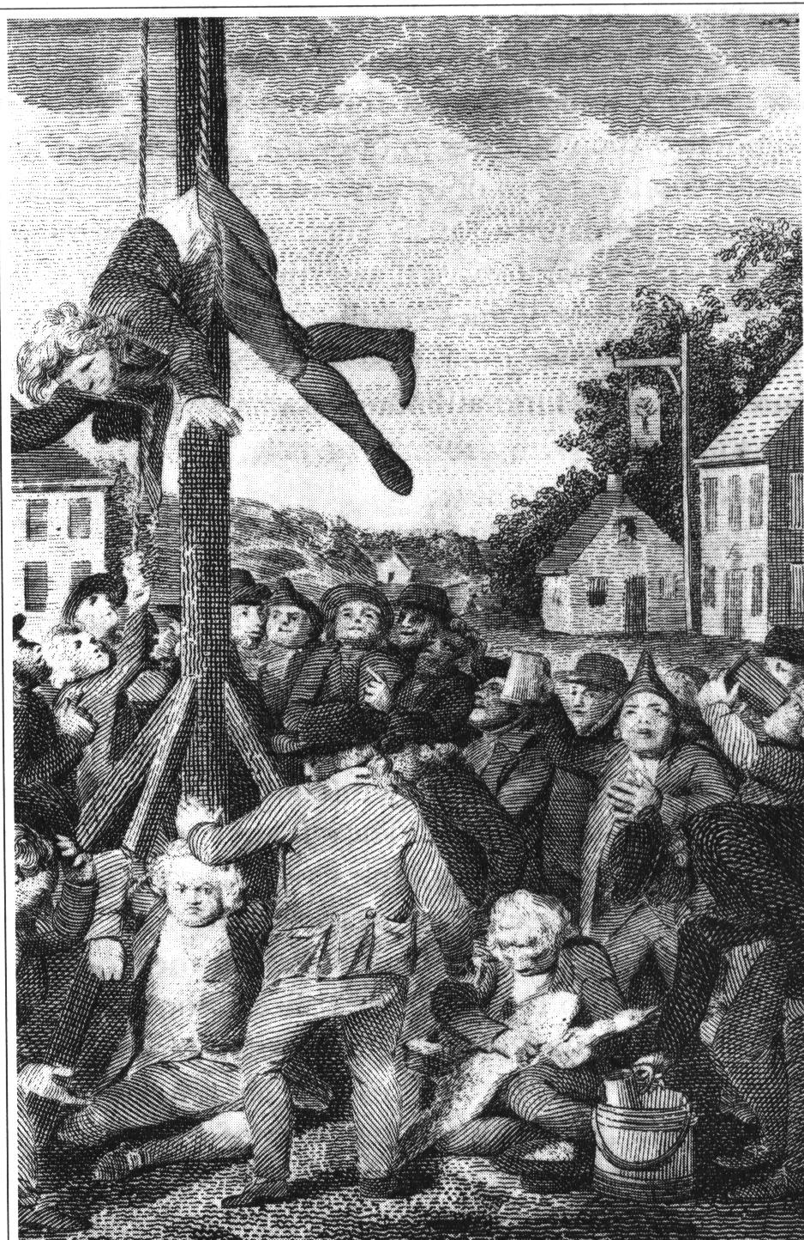
Staple Act of 1663
Crops like tobacco could only be transported to England for sale
Object was to cut countries like the Dutch out of the American trade
Colonials reaction
Notes:
Staple Act of 1663
Crops like tobacco could only be transported to England for sale
Object was to cut countries like the Dutch out of the American trade; revenues not only from the goods themselves, but the shipping as well went to England
Americans protested and some sought ways to circumvent and trade directly with Dutch and French
This led to more restrictions from England

Slide 17
1696: tightening the restrictions
Colonial governors forced to restrict foreign trade
Vice-Admiralty courts in the colonies
Board of Trade
Smuggling
Notes:
1696 Britain tightened enforcement procedures forcing governors to restrict foreign competition
Expanded the customs service and set up vice-admiralty courts in the colonies
Created the Board of Trade, a group that monitored colonial affairs closely and provided advice on colonial economics and trade
By the early 1700’s it appeared that these measures worked relatively effectively to channel benefits of colonial trade to England, although colonists frequently tried to find ways around them, including smuggling.

Slide 18
Conclusion
The period between 1675 and 1720 was an unsettling one in the American colonies, as Europeans jockeyed for supremacy over Native Americans and other Europeans. Along the Atlantic Coast, English colonists prevailed. The Spanish maintained supremacy in the Southwest, while the French remained most prominent in Canada. African slavery became more entrenched in the English colonies, and, while economic and settlement differences occurred, the colonies were for the most part more similar to than different from each other.

